Slide 1

Gurry App
Raúl Díaz Ródenas

Slide 2
Index
Introduction
Index
Why I choose this topic
Features
Conclusion

Slide 3
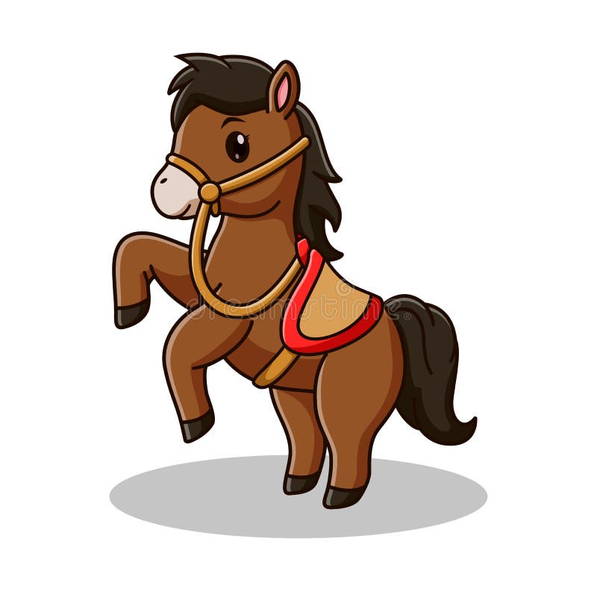


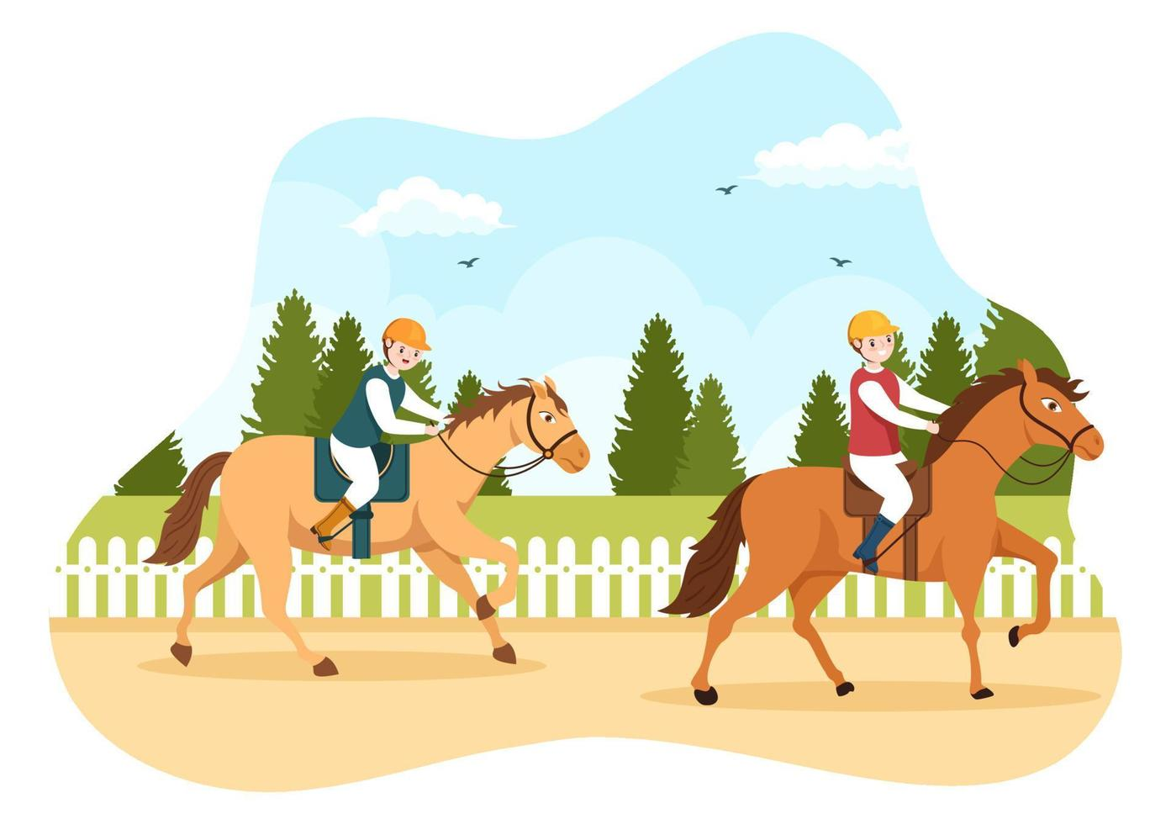

What is Gurry?
Gurry consists on a horse race mobile application where you can buy horses to participate in virtual races.

Slide 4

Why I choose this topic
Funny topic
A way to make horse races digital
There are many technics to implement

Slide 5




Features
Google Login
External database -> Firebase
User registration
Buy horses
See your horses

Slide 6
Test

Slide 7
Conclusion
This app could be a good personal project to publish it or for me CV

Slide 8
Thanks For your atention

